Slide 1
Identity and access management (IAM)
Velocity training institute
Shantanu Mahajan (sr engg devops)

Slide 2
IAM
AWS identity and access management service (IAM) is a web service that helps you securely control access to AWS resources for your users.
AWS Identity and Access Management (IAM) provides fine-grained access control across all of AWS..
With IAM, you can specify who can access which services and resources, and under which conditions.
With IAM policies, you manage permissions to your workforce and systems to ensure least-privilege permissions.
IAM is a feature of your AWS account and is offered at no additional charge.

Slide 3
IAM is/IAM Provides
Shared access to your AWS account.
Granular Permissions.
Secure access to AWS resources.
Integrated with many of the AWS resources.
Free to use.
Global service

Slide 4
IAM User
An AWS Identity and Access Management (IAM) user is an entity that you create in AWS to represent the person or application that uses it to interact with AWS.
A user in AWS consists of a name and credentials.
We can also create a user as a service account.
An IAM user with administrator permissions is not the same thing as the AWS account root user.
As a best practice, do not use the AWS account root user for any task where it's not required. Instead, create a new IAM user for each person that requires administrator access.
Then make those users administrators by placing the users into an "Administrators" user group to which you attach the Administrator-Access managed policy.

Slide 5
Tasks that require root user credentials
Change your account settings. This includes the account name, email address, root user password, and root user access keys.
Restore IAM user permissions.
Activate IAM access to the Billing and Cost Management console.
View certain tax invoices. An IAM user with the aws-portal:ViewBilling permission can view and download VAT invoices from AWS Europe, but not AWS Inc or Amazon Internet Services Pvt. Ltd (AISPL).
Close your AWS account.
And many more
https://docs.aws.amazon.com/general/latest/gr/root-vs-iam.html#aws_tasks-that-require-root

Slide 6
IAM User Groups
An IAM Group is a collection of users.
Group specifies the permission for a collection of users, and it also makes it possible to manage the permissions easily for those users.
You created a group known as Admin and assigned the permissions to the group that administrators typically need.
Any user in that user group automatically has the permissions that are assigned to the user group.
If a new user joins your organization and needs administrator privileges, you can assign the appropriate permissions by adding the user to that user group.
A user group is a way to attach policies to multiple users at one time.

Slide 7
IAM Groups
Following are some important characteristics of user groups:
A user group can contain many users, and a user can belong to multiple user groups.
User groups can't be nested; they can contain only users, not other user groups.
There is no default user group that automatically includes all users in the AWS account. If you want to have a user group like that, you must create it and assign each new user to it.
The number and size of IAM resources in an AWS account are limited. For more information, see IAM and AWS STS quotas.

Slide 8
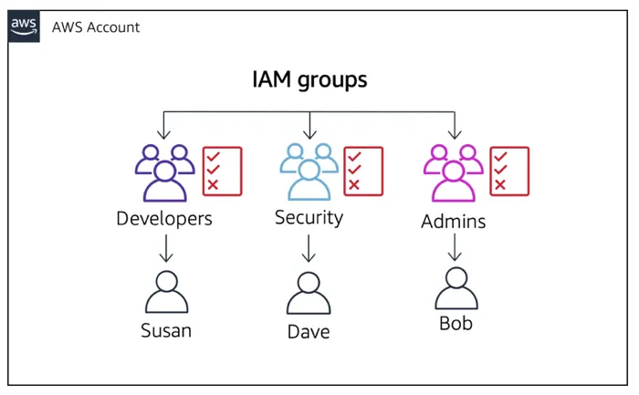

Slide 9
AWS managed policies
An AWS managed policy is a standalone policy that is created and administered by AWS.
AWS managed policies are designed to provide permissions for many common use cases.
Full access AWS managed policies such as EC2FullAccess and IAMFullAccess define permissions for service administrators by granting full access to a services.
Partial-access AWS managed policies such as AmazonEC2ReadOnlyAccess provide specific levels of access to AWS services without allowing permissions management access level permissions.
You cannot change the permissions defined in AWS managed policies.

Slide 10
Customer managed policy
Customer managed policies are standalone identity–based policies that you create and which you can attach to multiple users, groups, or roles in your AWS account.
You can manage and create policies using the AWS Management Console, the AWS Command Line Interface (AWS CLI), or the IAM API.
Recommended for use cases where the existing AWS Managed Policies don't meet the needs of your environment.
In order to create a Customer Managed Policy, you can copy an existing AWS Managed Policy and customize it to fit the requirements of your organization.

Slide 11
Inline policy
An Inline Policy is an IAM policy which is actually embedded within the user, group, or role to which it applies. There is a strict 1:1 relationship between the entity and the policy.
When you delete the user, group, or role in which the Inline policy is embedded, the policy will also be deleted.
In most cases, AWS recommends using Managed Policies over Inline Policies.
Inline Policies are useful when you want to be sure that the permissions in a policy are not inadvertently assigned to any other user, group, or role than the one for which they're intended (i.e. you are creating a policy that must only ever be attached to a single user, group, or role).
Inline polices are not reusable, means once attached to a single user/group they cannot be attached to other user.

Slide 12
Roles
An IAM role is an AWS Identity and Access Management (IAM) entity with permissions to make AWS service requests.
Basically this is nothing but service to service access.
Difference between role and policy:-
IAM roles define the set of permissions for making AWS service request whereas IAM policies define the permissions that you will require.
We assign a role to a aws resource to access another resource.
Eg:- Our EC2 instance needs access to S3, then we need to create a role for the same

